Slide 1
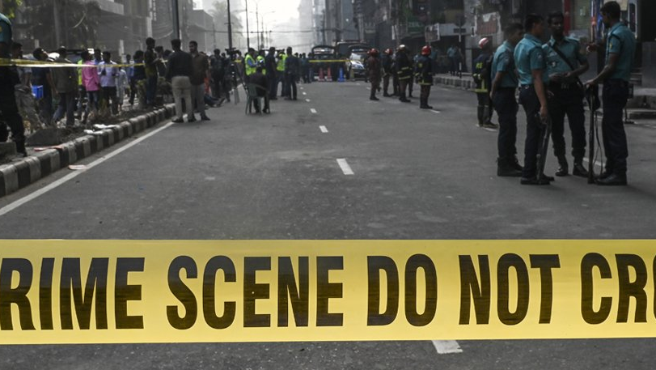
IN DHAKA CITY
CRIME
Presented by
SHOHANUR RAHMAN SHOHAN
FARJANA YESMIN OPI
LIDA KHAN MUKTI
NAZIM-E-ALAM
MD. ABU TOWSIF

Slide 2

What is
Crime
An act (or sometimes a failure to act) that is deemed by statute or by the common law to be a public wrong and is therefore punishable by the state in criminal proceedings
In ordinary language, a crime is an unlawful act punishable by a state or other authority
Criminology is the interdisciplinary study of crime and deviant behavior
In this presentation, we will discuss about the present and past scenario of crime in Dhaka city

Slide 3
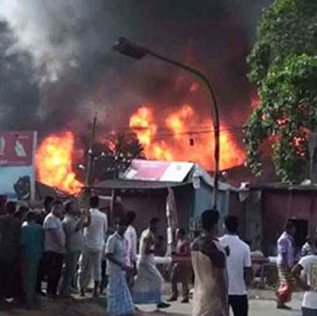
CRIME IN BANGLADESH OVERVIEW
Bangladesh, with its rich culture and history, is grappling with various types of crime that require comprehensive analysis and effective solutions
Crime is a multifaceted issue that affects societies globally, and Bangladesh is no exception
Rapid urbanization has led to increased population density and crime concentration
The rise of cybercrime has introduced new challenges, requiring the adaptation of traditional law enforcement strategies to the digital realm

Slide 4
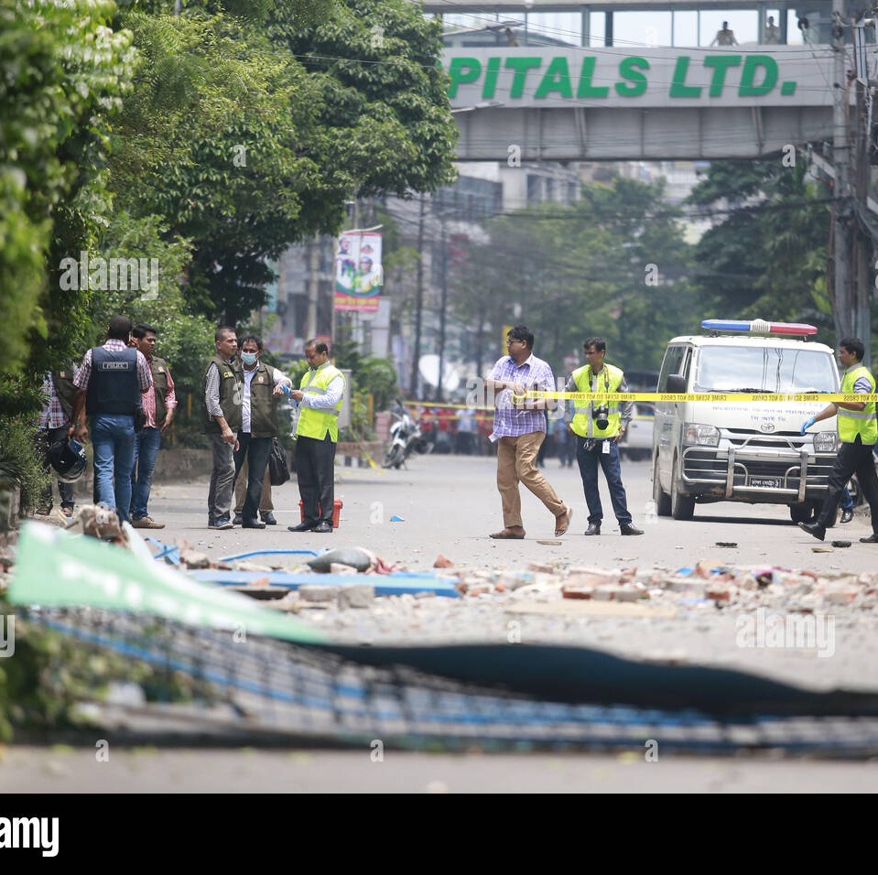
CRIME IN DHAKA CITY
Dhaka City, the bustling capital of Bangladesh, grapples with a diverse range of criminal activities that reflect the complexities of urban life
From street crime to cybercrimes, Dhaka City's crime landscape encompasses a spectrum of offenses that challenge law enforcement and society
Violent crimes, such as robberies and assaults, pose threats to public safety, prompting a need for strategic measures to ensure citizen protection
Women's safety remains a pressing concern, as gender-based violence and harassment persist in various corners of Dhaka City

